Slide 1
Topic: Algebra EQ: What Are the KeyWords in Algebra?
Year 8 Mathematics
Mrs Parlevliet

Slide 2
Contents
Glossary or Formula Page
Page
Date
Description

Slide 3
Tasks
24
7
30
Essential Question
Questions
Notes
Summary
1
2

Slide 4
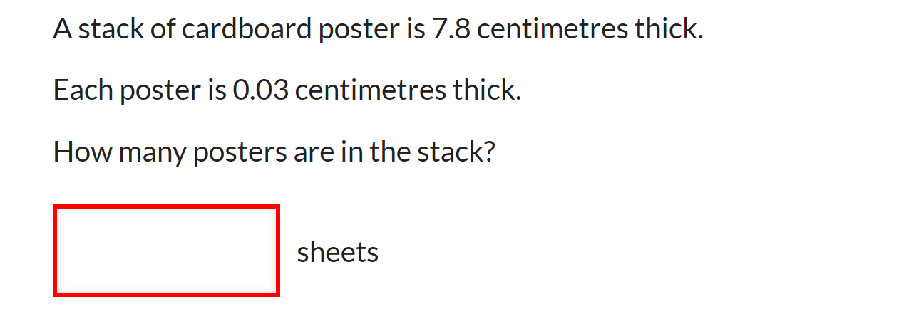

Five Questions (LHS)
Date: __/6/2019
Topic: Algebra
EQ – What are the keywords in algebra?
What is the area of a circle with a diameter of 7cm?
Calculate the perimeter of a semi circle with a straight line edge of length 10cm.
Divide $540 in a ratio of 2:4
What does $x$ need to be to make $x+7=13$ true?

Slide 5
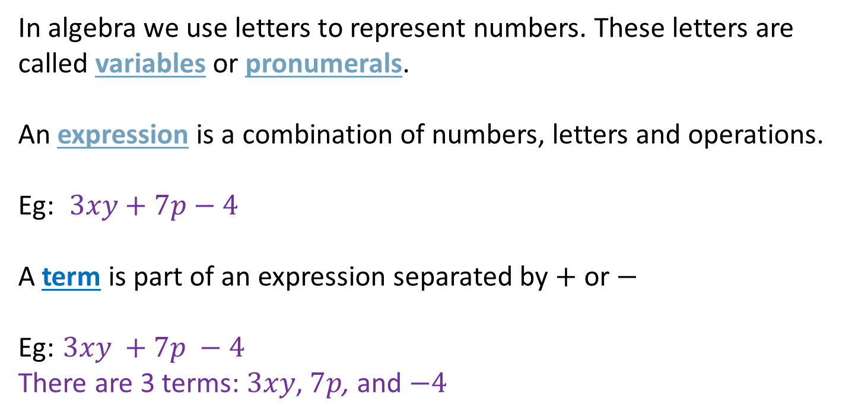
24
7
30
Algebra
WICOR
Date: __/6/2019
EQ – What are the keywords in algebra?
In algebra we use letters to represent numbers. These letters are called variables or pronumerals.
An expression is a combination of numbers, letters and operations.
Eg: $3xy+7p−4$
A term is part of an expression separated by $+$ or $−$
Eg: $3xy +7p −4$
There are 3 terms: $3xy$, $7p$, and $−4$

Slide 6


Slide 7
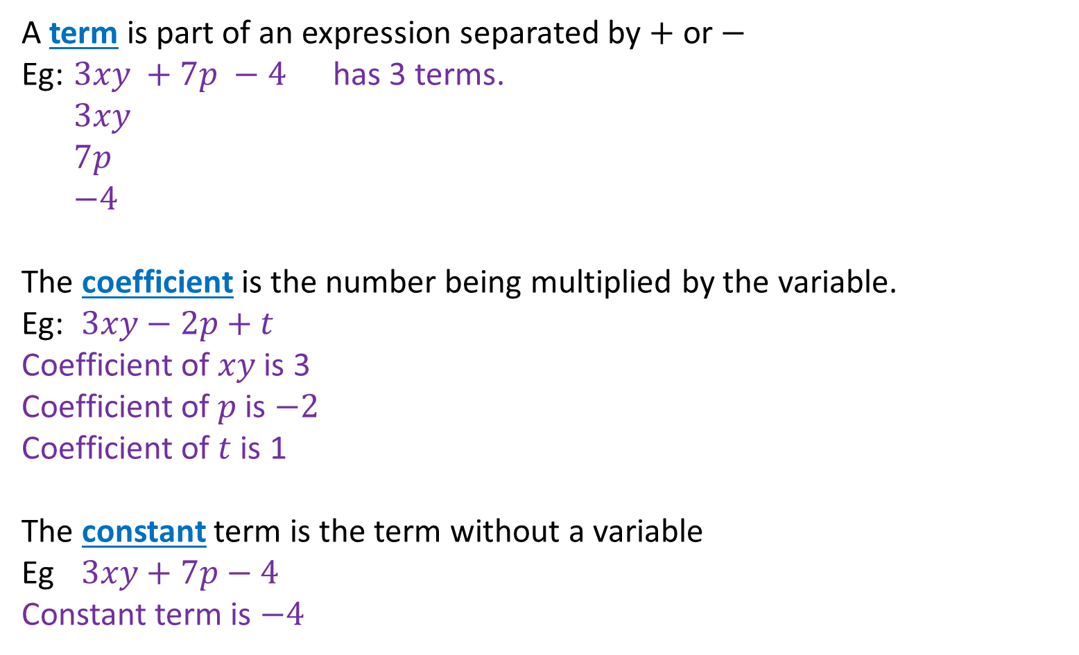
24
7
30
Algebra
WICOR
Date: __/6/2019
EQ – What are the keywords in algebra?
A term is part of an expression separated by $+$ or $−$
Eg: $3xy +7p −4$ has 3 terms.
$3xy$
$7p$
$−4$
The coefficient is the number being multiplied by the variable.
Eg: $3xy−2p+t$
Coefficient of $xy$ is 3 Coefficient of $p$ is $−2$
Coefficient of $t$ is 1
The constant term is the term without a variable
Eg $3xy+7p−4$
Constant term is $−4$

Slide 9

Write Your SUmmary
You have 3 minutes to write a summary that answers the Essential Question.
Be prepared to share your summary with the people sitting in your row.
This Photo by Unknown Author is licensed under CC BY-NC-ND

Slide 10
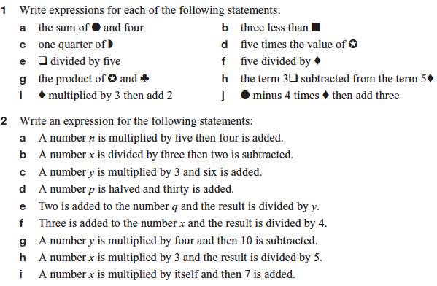
Task (LHS)

